Slide 1
How might Fine Art students engage with peer learning to become more confident in their approach to contextual research?
Notes:
Fine Art students are relatively confident in approaching independent study in their studio work, however, often feel disconnected from practising independent Contextual Studies research.
This project took the form of a peer learning research skills workshop aimed to motivate students towards participating in a community of essay practice.

Slide 2
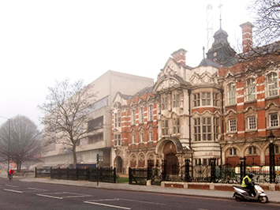
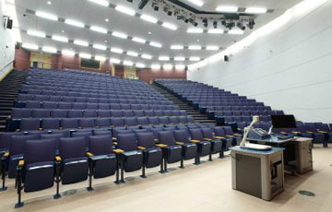
Problem #1
Problem logistics = Problem learning
Sculpture Studios
(Barbarian Territory)
Contextual Studies Office
(Bastion of Intellect + Civility)
Even the styles of the architecture enforce a Great Divide
Hallowed Lecture Theatre 500m down the road
Notes:
One of the key issues with Contextual Studies learning is logistics – Contextual Studies is delivered in set classes held in lecture theatres, far away from student’s studios and practical work.

Slide 3
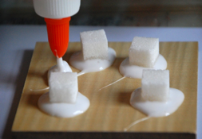
Contextual Studies environments are so very intellectually intimidating
This student works with cubes, so has written an essay about an artist who worked with cubes 50 years ago. It’s a very superficial connection.
They’ve learned nothing that might help develop their own ideas.
Problem # 2 Students don’t SEE
the relationship between Contextual Studies and studio practice.
Student’s work:
Sugar Cube + Glue DIY
(fictional example found on internet)
(actual essay topic from previous year)
“Was Donuld Jud a Minamilest?”
Essay by YR2
Fine Art Student
My Alter Ego
Patricia Ellis: 1930s Film Starlet
Notes:
Student’s own artworks are unique don’t fit neatly into themed lecture topics. Consequently they often struggle to identify and pursue their own research interests in a personally specific and meaningful way.

Slide 4
Studio (Social Environment)
Problem #3
Students need a community of essay practice
Essay writing is so lonely.
Essay (Solitary Activity)
Notes:
Studios are a communal environment where students regularly engage with peer learning – whereas Contextual Studies essays are seen as a solitary activity.

Slide 5
So… I asked my students…
Notes:
Fine Art students are relatively confident in approaching independent study in their studio work, however, often feel disconnected from practising independent Contextual Studies research.
This project took the form of a peer learning research skills workshop aimed to motivate students towards participating in a community of essay practice.

Slide 6
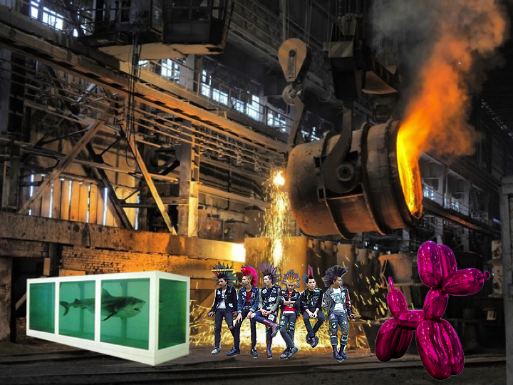
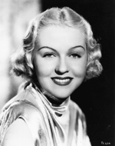
What are your strengths / weaknesses in researching essays?
Do you think academic essays are useful for your practice?
The studios are a very different culture than the lecture theatre
Finding a topic that relates to my work
Not knowing if my research is relevant
I dunno, essays are kind of useful, I guess
Finding relevant research
I can’t read
I like essays, me
Masterpieces
Students
Masterpieces
Notes:
Prior to doing the workshop, I asked students about their attitudes and behaviours towards essay research, and students advised that the workshop should place emphasis on identifying relevant research areas, theory application, and developing essay topics that relate more directly to their practices and interests.

Slide 7
Then we did a crit…
but instead of discussing making works, students looked at each other’s works and discussed possible research themes and materials…
Notes:
Fine Art students are relatively confident in approaching independent study in their studio work, however, often feel disconnected from practising independent Contextual Studies research.
This project took the form of a peer learning research skills workshop aimed to motivate students towards participating in a community of essay practice.

Slide 8
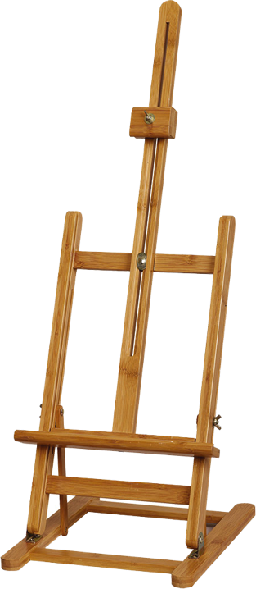
I want to write about motherhood
In Studio
Essay Brainstorming Workshop
Cool idea Marc Quinn, but could you make your topic more specifically reflective of your work?
Have you read Kristeva?
Marble makes me think of ancient Greek sculptures’ body ideals
I’m supposed to be taking notes, but I contributed lots to the discussion
Note Taker: Year 3 Dissertation student
Dude, she’s disabled – that really challenges perceptions about beauty
Notes:
The workshop was held in the students studios, where their artworks were viewed by the group. Instead of discussing making concerns, students gave each other suggestions for how their works might be interpretted more broadly, and various avenues of research that might be pursued.
I asked a Year 3 student to act as a note taker – and she eagerly began to participate in the discussion. This was unanticipated – but a very positive contribution.

Slide 9
2 weeks later…
we discussed the crit
Notes:
Fine Art students are relatively confident in approaching independent study in their studio work, however, often feel disconnected from practising independent Contextual Studies research.
This project took the form of a peer learning research skills workshop aimed to motivate students towards participating in a community of essay practice.

Slide 10
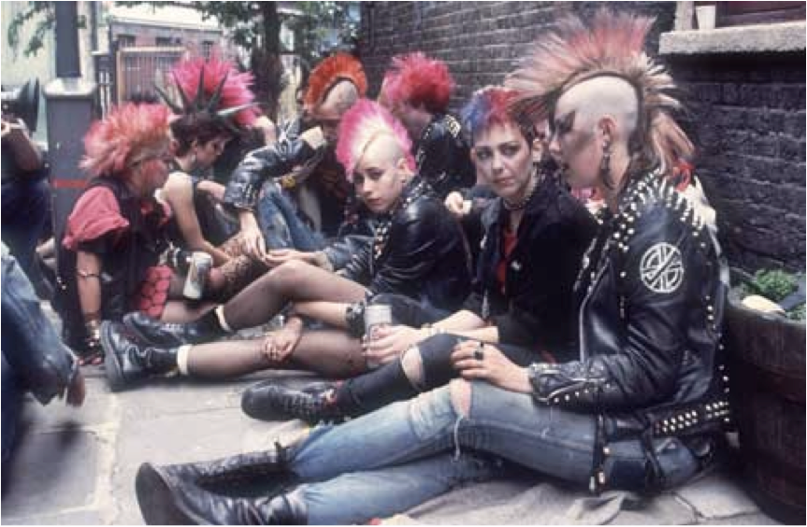
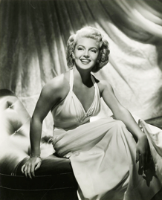
Yes. I am now looking at my own practice more and trying to understand my own interests and concerns.
Problem #1:
Did your essay ideas change as a result of studio based discussion?
I used to have a stuffy attitude towards research. Am now more relaxed, understand non-academic work/references can be used
[our theory learning] needs to be more creative/interactive to result in a better learning outcome. E.g. Workshops/practical activities.
Do more things like that, instead of just a crit – like: what is Jen’s work about? Just at the point of impact, that’s really helpful.... It lets you contextualize your work in the art world or theory.
Notes:
Students also fedback that the workshop exercise was useful in considering the ideas within their own practice more, and taking a more personally invested approach to research. They especially enjoyed Contextual Studies being taught in a creative way, in direct relation to their own practices.

Slide 11
Problem #2:
Did the workshop help clarify how you might approach essay research?
The problem is we all know the same stuff
It’s helpful to compare essays, to understand what you’re doing yourself. To talk out loud what’s in your head makes more sense.
Helping other classmates with essays is also useful as it’s good to know what everyone else is doing.
I think other people needed to contribute a bit more. I was doing a lot of talking, but didn’t get much back.
I found this essay more enjoyable. Also how we have had to think about and most importantly talk about (with our peers) the essay. This has meant a more developed line of thinking.
It seemed like a really brilliant experience – but I don’t feel I got much advice.
Discussing my essay idea out loud to peers helps me affirm what I want to write about…
Notes:
Stduents feedback on the workshop was mixed, with some students feeling that peer discussion helped them become more confident and have clearer thinking in relation to their essay research, while others felt they’d given valuable suggestions to their peers, but received little ‘quality’ feedback in return. One student insightfully said: The problem is we all know the same stuff.

Slide 12
I’m going to involve Year 3 and post-grad students next year.
Problem #3: Community of Practice
A community of practice involves ‘becoming’ – which is a gradual process:
As a perceived expert, students find me intimidating.
As peers, students don’t value each other’s authority – they are all at the same knowledge level.
But we thought the note taker was AMAZING!
The note taker however was a Year 3 student who had just completed her Dissertation – she has a higher level of knowledge and because she was closer to my student’s age and status, was seen as a “more credible model”.
Notes:
This highlighted the importance of considering the dynamics of community of practice. As a perceived expert, students find me intimidating. As peers, students don’t value each other’s authority. The note taker however was a Year 3 student who has just completed her Dissertation – she has a higher level of knowledge and because she is closer to my student’s age and status, was seen as “more credible model”. This makes a strong case for more cross year group interaction with in the curriculum.

Slide 13
Problem #3: Community of Practice
MOST IMPORTANT OUTCOME
Through peer discussion, the workshop empowered students to consider the validity and importance of their own academic participation – making ‘academic literacy’ more inclusive.
Notes:
Perhaps the most important outcome of this workshop is in how peer learning can be used to situate contextual studies research in the students’ own domain. Through peer discussion, students were empowered to consider the validity and importance of their own academic participation.

Slide 14
With thanks to…
Thomas, Jones and Ottaway (2015) “Effective practice in the design of directed independent learning opportunities”
Topping (2005) “Trends in Peer Learning”
Keith Topping
Gibbs (2010) “The Dimensions of Quality.”
Lea & Street (1998) “Student Writing in Higher Education: An Academic Literacies Approach”
Lea (in Barton & Tusting 2005) Beyond Communities of Practice: Language, Power, and Social Context
Expertise
(Old Timers)
Legitimate Peripheral Participation
(New Comers)
Effort is socially learned
Lave (1991) “Situating Learning in Communities of Practice”
Mary R. Lea

